Slide 1
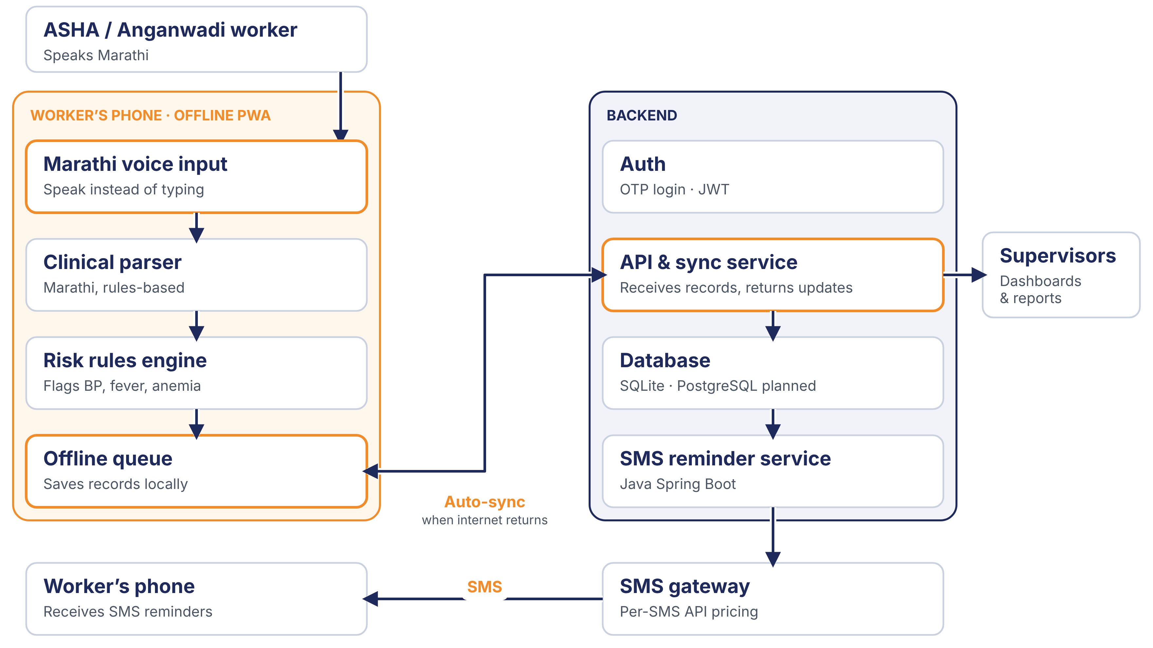
SEVA INNOVATION CHALLENGE 2026 • TEAM KRYPTHON
Marathi-First Offline Health Assistant
A Marathi-first, offline-first health assistant with voice-assisted visit entry and a built-in clinical rules engine to record visits, flag risks and track follow-ups.
Concept at a glance
An installable web app (PWA) for basic smartphones in rural Maharashtra.
Marathi speech entry when available; offline audio capture or quick presets. Visits queue for sync; follow-ups stay in-app.
Notes:
Title slide. Fill every field exactly as entered in the online application form so reviewers can match the deck to the application.

Slide 2
2
The Problem
What real challenge in society, government service or industry are you solving?
What is the problem?
Who is affected, and where?
ASHA and Anganwadi workers struggle to complete timely follow-ups for pregnant women and children. Most digital tools require English or Hindi, typing skills and constant internet, while paper registers consume time and can delay or miss high-risk records.
Approximately 50,000–70,000 ASHA and Anganwadi workers across rural Maharashtra, serving more than 20–25 lakh pregnant women and children under five each year.
50,000–70,000
ASHA and Anganwadi workers across rural Maharashtra
Evidence
Current gaps
Why it matters
Estimated target reach: 50,000–70,000 frontline workers and 20–25 lakh mothers and young children annually.
Paper registers are slow to update. Existing apps are often not Marathi-first, rely on typing, and need continuous connectivity—making them difficult to use in remote villages.
Delayed follow-ups can leave high-risk mothers and children without timely care and reduce the quality of government health data.
Seva Innovation Challenge 2026 | Slide 2 of 6
Notes:
Reviewers look for a clearly defined, real and significant problem backed by evidence. One strong statistic is better than many weak ones. Cite the source for every number.

Slide 3
3
Our Solution & Innovation
What have you built or designed, how does it work, and what is new about it?
Our solution in brief
What makes it new?
A Marathi-first PWA for basic smartphones. Workers use speech-to-text when available, or capture audio/use quick presets offline. A rules-based parser flags risks; visits queue for sync and follow-ups stay in-app.
 | Existing approach | Our approach
Cost | Paper and admin burden | Uses existing smartphones
Speed / time | Manual updates; delayed follow-up | Voice entry + SMS reminders
Reach / access | Language and network limits | Marathi-first and offline
Ease of use | Registers or typing | Speak naturally in Marathi
How it works
1
2
3
Input
›
Process
›
Output
Speech entry when available; offline audio or presets
Rules-based risk flags; follow-ups tracked in app
Queued visits sync later; supervisors view dashboards and reports
Key USP
Marathi voice entry when supported, offline visit queue/audio capture and explainable clinical risk flags for basic smartphones.
Seva Innovation Challenge 2026 | Slide 3 of 6
Notes:
Show clearly how the solution addresses the problem on Slide 2. Compare against what exists today — reviewers score originality and relevance here.

Slide 4
4
Feasibility & Implementation
How ready is the solution, and what will it take to implement it on the ground?
Current stage (mark ✔ where you are today)
Idea
Proof of Concept
✔ Working Prototype
Field Pilot
Ready to Deploy
Technology
Estimated cost
Timeline
Partners
Next.js PWA with local visit queue/sync, Marathi rules-based parser, browser speech-to-text when available, offline audio capture, OTP/JWT login and SQLite. Configurable SMS gateway supports OTP delivery.
Open-source; no licence fees. Optional SMS gateway costs vary by provider and OTP volume.
Pilot estimate: confirm after provider selection
At scale: model after pilot traffic
Done: working prototype. 3 months: field testing, PostgreSQL move. 6 months: pilot with 20–30 ASHA workers in one block. 12 months: evaluate and plan district rollout.
Public Health Department, Women & Child Development / ICDS, block and PHC officials, and an implementation or community-health partner.
Seva Innovation Challenge 2026 | Slide 4 of 6
Notes:
Be realistic. A clear, costed plan with an identified adopting department scores better than an ambitious but vague one. Mention any validation already done (tests, user feedback, certifications).

Slide 5
5
Impact & Scalability
What change will your solution create, and how can it grow beyond the first location?
20–30
30–40%
50K–70K
Beneficiaries reached
Saving in cost / time
Frontline workers
ASHA workers in the first block-level pilot
reduction in record-entry and follow-up time during pilot (estimated target)
potential scale across rural Maharashtra
Social impact
Sustainability
Scale-up plan
Faster and more complete maternal and child follow-ups; fewer missed high-risk cases; less paperwork; more accessible and inclusive digital support; and better data for government decisions.
Use existing smartphones and an offline-first design to control costs. Long-term operation can be supported through departmental budgets, public-health programmes, CSR or implementation partners.
Start with 20–30 ASHA workers in one block, measure usability and outcomes, refine the Marathi voice workflow, then expand district by district and extend the rules engine and language support to other states.
Seva Innovation Challenge 2026 | Slide 5 of 6
Notes:
Quantify impact wherever possible and state your assumptions. Where relevant, link the solution to an existing Government scheme, mission or the Sustainable Development Goals.

Slide 6
6
Team/Individual & Support Required
Who is behind the idea, and what help do you need from the Challenge?
Harshika Thopte
Support we are seeking
Project lead & Backend Developer
Mentorship & technical guidance
https://github.com/Hari-Thopte
Pilot with a government department
Funding / grant support
Ishan Sonawane
Team Member & Frontend Developer
Incubation & workspace
https://github.com/Ishan-sonawane
Testing, certification or IP support
Challenge support will help us refine the working prototype and run a 20–30-worker block-level pilot, generating evidence for wider government adoption.
Faculty guide: Mr. Pramod Patil [Assistant Professor]
Thank you
[harshikathopte@gmail.com / 8329373147]
[Ishan.naruto10@gmail.com / 8108090272]
Seva Innovation Challenge 2026 | Slide 6 of 6
Notes:
List only active team members. Be specific about the support requested — it helps the organisers match you with the right mentor, department or incubator.

